Slide 1


Logo design
Sithija Wijesinghe
Notes:
Getting started with the logo design

Slide 2

Logo Design
Objectives was to create a logo for the Humanities and Engineering SIG.
Values of Humanities and Engineering SIG
Promoting collaboration between researchers.
Enabling networking and a system to connect with researchers.
Multidisciplinary group with educators, academics, artists, and engineers working together.
Engineers who go beyond engineering and non-engineers who bring their perspectives to engineering.
Notes:
The objective was to create a logo for the Humanities and Engineering SIG.
Therefore to create an adequate logo for the client we have to understand their values.
Looking at the values of the Humanities and Engineering SIG, we can see that they are extremely interested in promoting collaboration between researchers and to enable networking.
As they are a diverse group of individuals who share common interests, they have professionals who are educators, academics, artists, and engineers.
Furthermore, the SIG appreciates and encourages engineers who go beyond engineering and non-engineers who bring their perspectives to engineering.

Slide 3

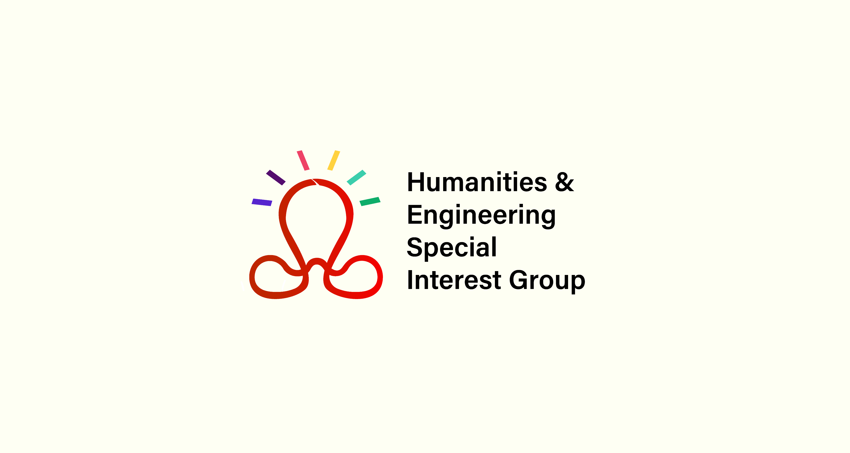
Logo Design
Minimalist design The latest industry trends are to design logos that are abstract and minimalist. The logos are designed in a convey a message using patterns instead of objects.
Notes:
Here I present the logo that I have designed for the Humanities and Engineering Special Interest group.
As the design logo needs to relevant, we have to look at the trends that the industry follows.
Currently, minimalist design with the use of abstract patterns to convey a message is widely used.

Slide 4

Logo Design
Mobius strip Networking, collaboration, and unboundedness. The endless nature and non-orientable.
Bulb and light strips Innovation, ideas, creativity, and inclusiveness. The even number of strips show that no one is left out
Notes:
The design of the logo was inspired by the mobius strip.
The mobius strip is a mathematical object that has a non-orientable surface.
As the logo is for the humanities and engineering SIG, this is a great concept as it is a mathematical concept that is useful in engineering while the non-orientable surface relates to the complexities of humanities.
The endless loop signifies networking and collaboration.
The mobius strip is used as a signifier for networking, collaboration, and unboundedness of the SIG.
The shape of the bulb is a natural mapping for a new idea and it is used here to represent innovation, ideas and creativity.
The light strips are used to emphasize the bulb showing that new ideas are appreciated and encouraged.
There are 6 light strips in the logo, which is an even number and is used to signify that no one is left out.

Slide 5

Logo Design
Wave Fluidity, transformation, dynamism. People going beyond their discipline
Red colored main logo Encouragement and passion. Connected to CEEA
Different colored light strips Inviting, multiculturalism, unity, inclusiveness.
Notes:
The shape of a wave is a natural mapping for an ocean which is used here to represent fluidity, transformation and dynamism.
The is a depict the individuals who go beyond their discipline.
The wave combined with the mobius strip signifies that individuals from different disciplines are networking and collaborating.
The main section of the logo is colored in red to signify that it is not a standalone group but a part of CEEA.
Further, red is the color used to represent encouragement and passion which are ideal to the Engineering and Humanities SIG.
The light strips are colored with different bold colors.
Bold colors are used to represent that the group is inviting and welcoming to existing, new, and future members and collaborators.
Furthermore, the multicolored strips represent multiculturism, unity, and inclusiveness.

Slide 6
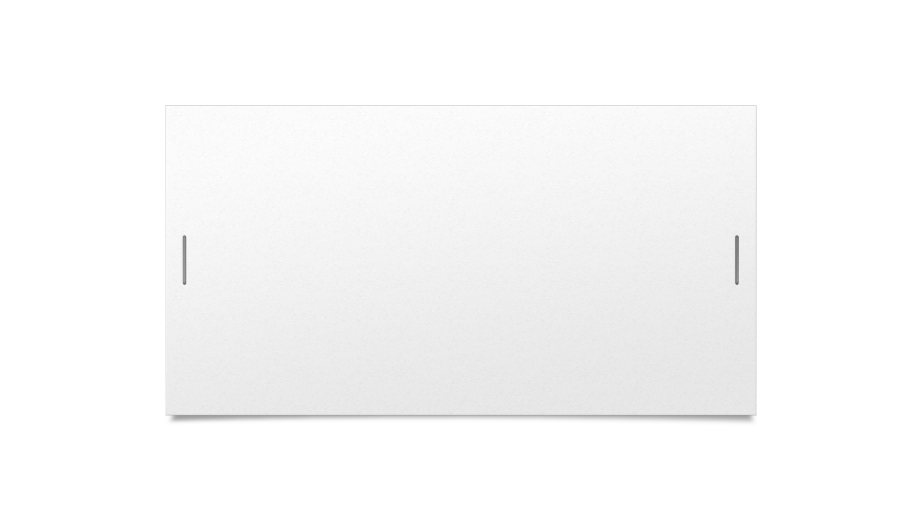

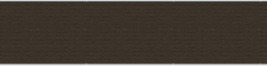

Thank you
Sithija Wijesinghe

